Slide 1
SQL PROJECT CHINOOK MUSIC STORE DATABASE
RAHUL DEVEL

Slide 2
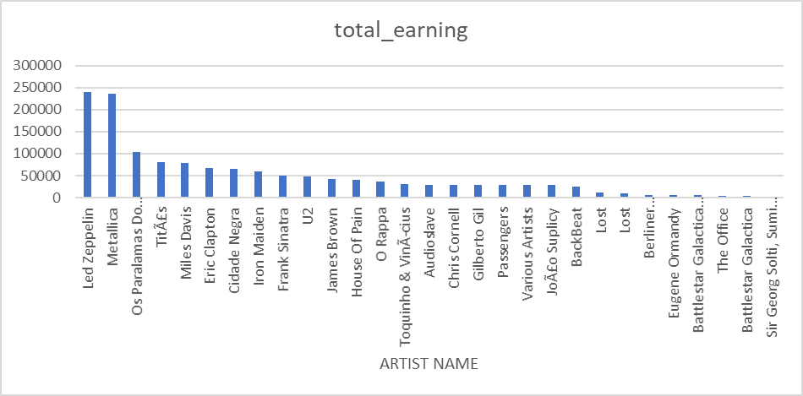
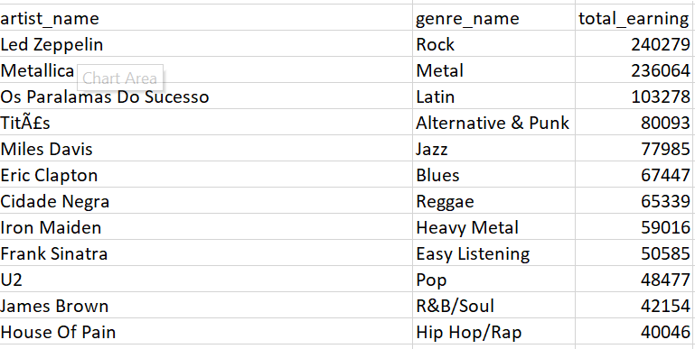
WHO ARE THE TOP EARNING ARTIST IN EACH GENRE?
The top earning artist in each genre has been shown in charts and table. SQL query was executed to find the most sales earning by invoice line (price * quantity).
We can clearly find from the visuals that the top earning artist is Led Zeppelin in Rock genre (240279) and Metallica is the top earning artist in the metal genre. Below is the 15 top earning artist in their genre respectively.

Slide 3
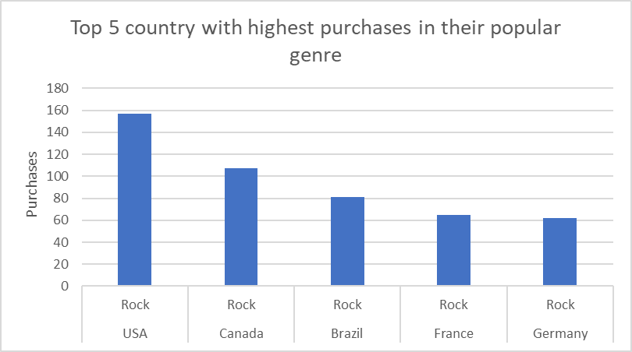
Which are the top 5 countries with highest purchases in their popular genre?
The above bar charts shows highest amount purchases in top 5 country in their popular genre. SQL query was executed from which the above information was extracted and limited to the top 5 countries. We can see that the US has the most purchases in rock genre (157) followed by the Canada (107). It is clear from the above visuals that is rock is extremely popular genre and also very successful.

Slide 4
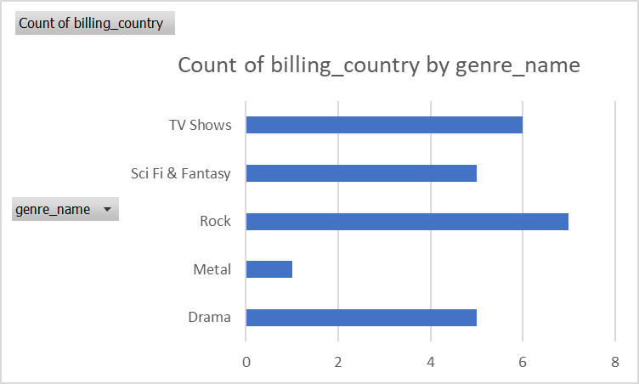
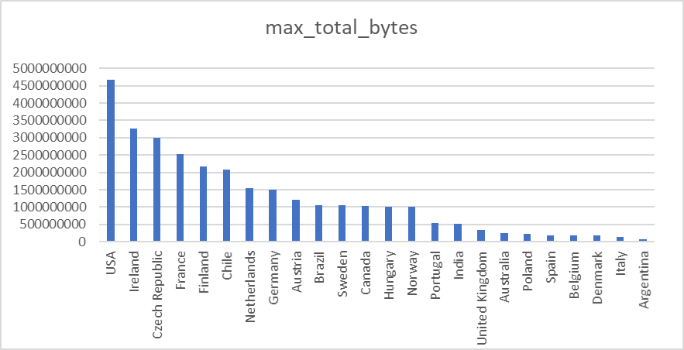
What is max total bytes of track sold per genre in each country popular track in each country?
The above bar charts highlights the maximum total bytes of tracks which is sold per genre in each country. We can clearly see that Rock genre has the most buyers in terms of count of country and US is the number 1 country in terms most bytes sold and Argentina is lowest. TV shows genre has the most sales in US.

Slide 5
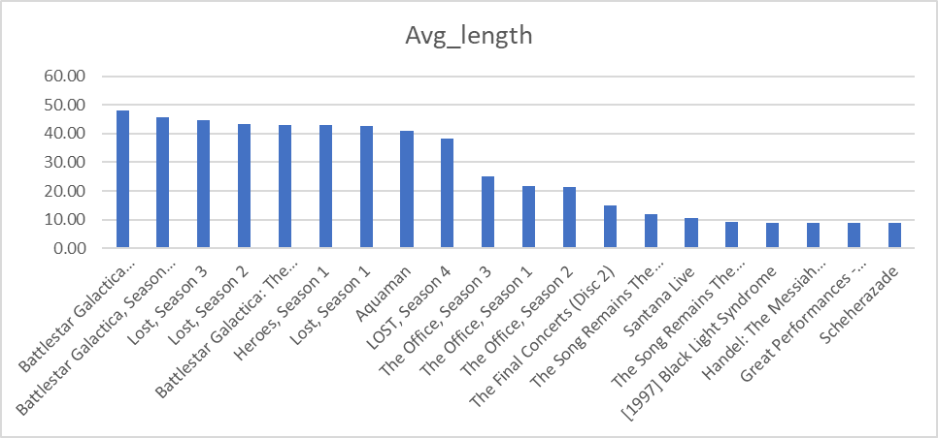
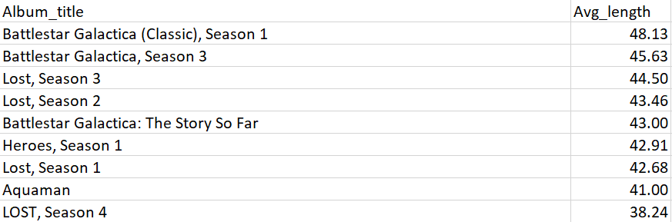
What is the average duration in minutes for each album?
A SQL query was executed to find the average duration length in minutes for each album. From the bar chart, it is clearly visible that Battlestar Galactica Season 1 has the longest average duration (48.13) while Scheherazade has the shortest average duration (9).

